Slide 1
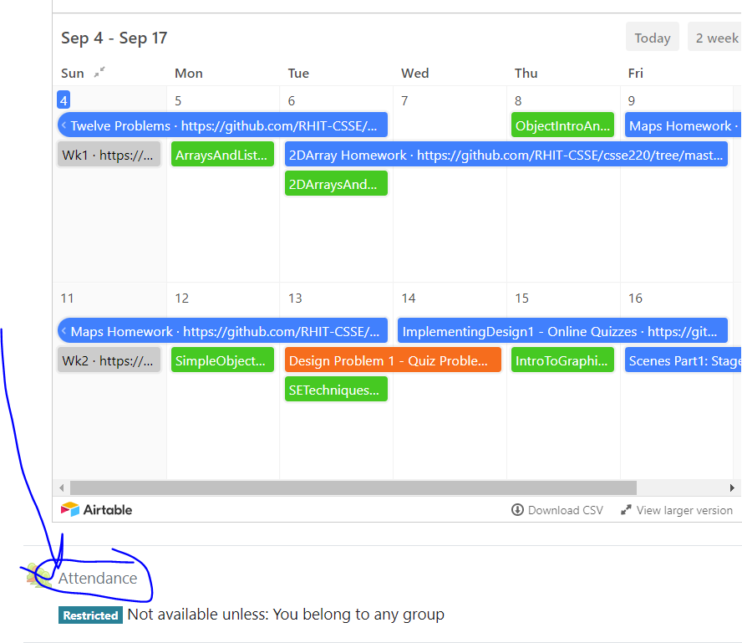
CSSE 220
Today’s Attendance password
__________
Primitive Types: Part1-JavaPrimitiveTypes.pptx
Arrays: Part2-JavaBuiltInArrays.pptx
ArrayLists: Part3-JavaArrayLists.pptx
The git projects for today are:
PracticeArrayList
PracticeArrayListSolution
Notes:
Aim to have them working on arrays in the 1st hour and arraylists in the second hour

Slide 2
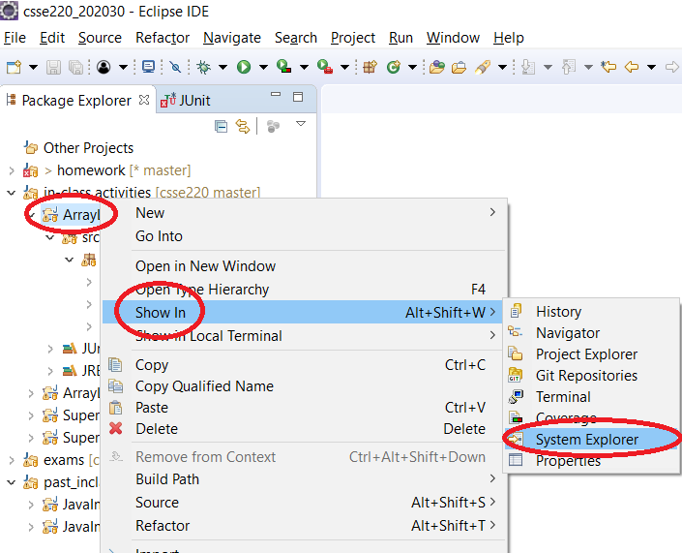
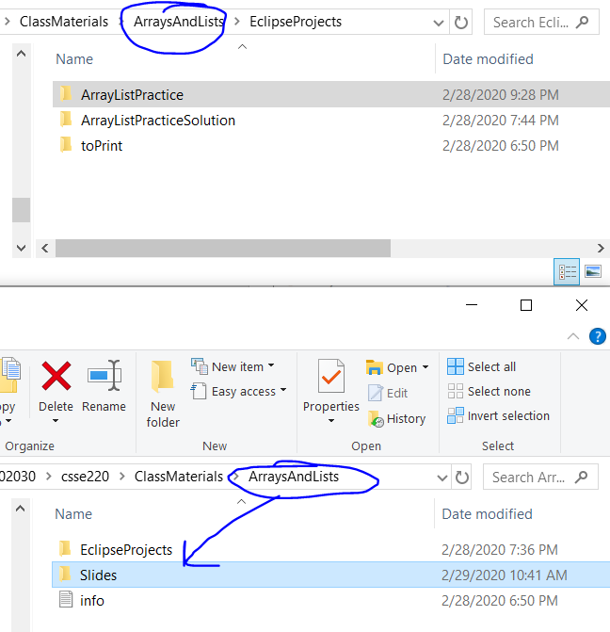
How to access slides (from Eclipse)

Slide 3
How to access slides (from Internet)

Slide 4
Speed With Which Things Move
Moving up a level in speed
Anticipate:
Go through slides before class
Familiarize yourself with terminology
Read the Big Java chapters
Write down questions for instructor
Ask questions in class, or hand piece of paper with questions to instructor at beginning of class

Slide 5
Getting things done
If something has a hard deadline, then set a reminder in your smart device
Live by: “if I don’t do it now, it won’t get done”
Speaking of which… HW1…
Notes:
Go over solution from HW1 to make sure students get the answer
intentionally introduce error in HW1 as you go. order of operations. different approaches.

Slide 6
JavaIntro, HW1, TwelveProblems
Any questions: feel free to ask individually
JavaIntro will not be collected and graded
Intended to help you learn
Not intended as busy work
TwelveProblems
Due date on schedule page
First half you can probably do already

Slide 7
Syllabus Highlights

Slide 8
Syllabus Highlights
Course policies
Late Assignments
Grading
Collegiality
Schedule
Etc.

Slide 9
Array Practice Opportunity
Form groups of 2
Navigate to: http://codingbat.com/java/Array-2
Work in your groups to solve: fizArray3, bigDiff, shiftLeft
If you finish early, try: zeroFront
Create a file called CodingBatPractice.java
Save your codingbat work by copy and paste into this file

Slide 10
Work Time
Work on TwelveProblems
Notes:
As time allows:
1. See if anyone is asking about static, give simple explanation
2. Possible elaborate on an auto-boxing diagram

